Slide 1
Design gallery
Presented by
P.LAKSHMAN BABU

Slide 2
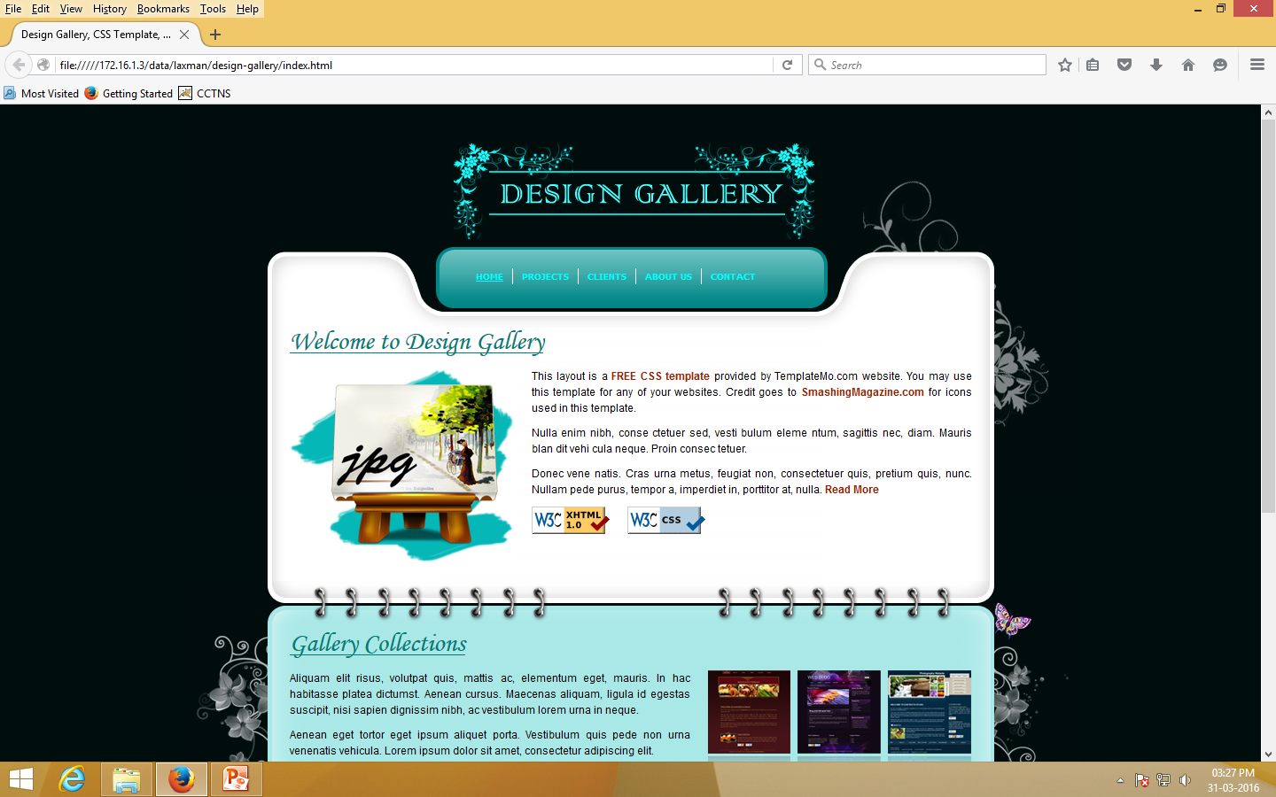
DESIGN

Slide 3
ABOUT DESIGN
Design is the creation of a plan or convention for the construction of an object or a system (as in architectural blueprints, engineering drawings, business processes, circuit diagrams and sewing patterns).^{[1]} Design has different connotations in different fields (see design disciplines below). In some cases the direct construction of an object (as in pottery, engineering, management, cowboy coding and graphic design) is also considered to be design.
Designing often necessitates considering the aesthetic, functional, economic and sociopolitical dimensions of both the design object and design process. It may involve considerable research, thought, modeling, interactive adjustment, and re-design. Meanwhile, diverse kinds of objects may be designed, including clothing, graphical user interfaces, skyscrapers, corporate identities, business processes and even methods of designing.^{[2]}

